Slide 1
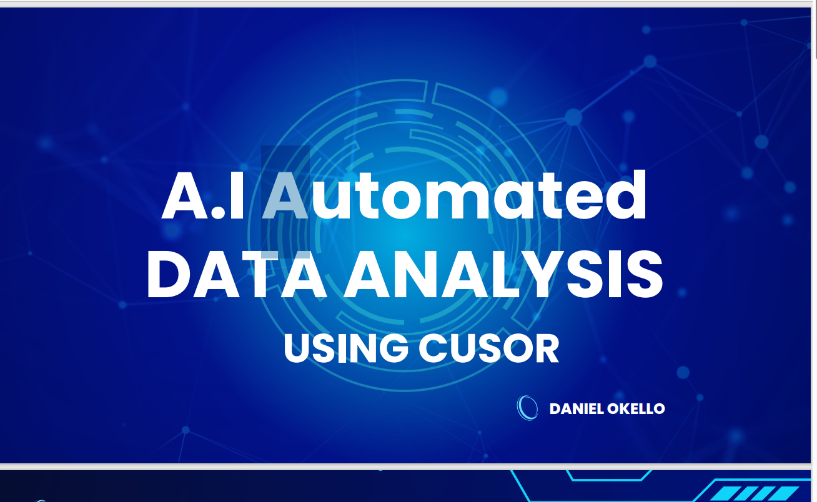

Slide 2
Presentation Outline
1
Project Objective
2
Introduction to Cursor IDE
3
Expected Outputs
4
Case Study Project

Slide 3
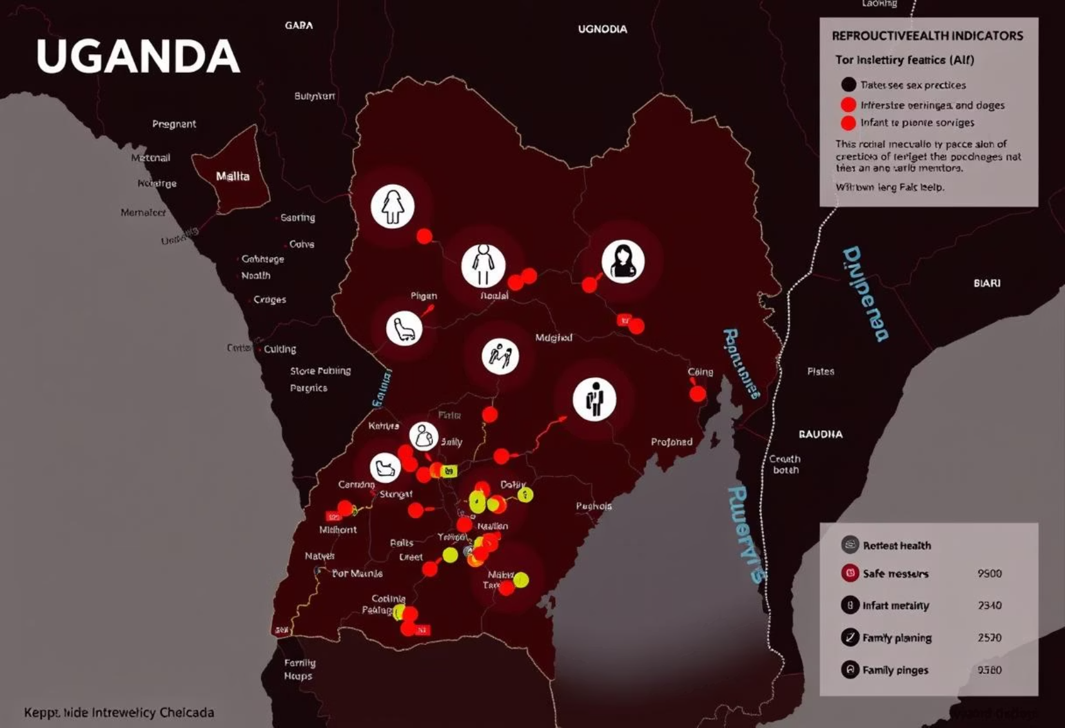
1.0 Objective:
This presentation aims to showcase AI-assisted data analysis using Cursor on the 2016 Uganda Demographic and Health Survey. The primary focus is on Adolescent reproductive health behavior among girls aged 15-19.
Specific Objective:
Compile a concise report (HTML or PDF) analyzing reproductive health and behavior indicators by background characteristics. This involves examining factors like residence, education, and wealth.
Design SVG for Findings using Claude.aI

Slide 4

2.0 Introduction: Cursor IDE
Cursor is an advanced Integrated Development Environment (IDE) designed to enhance the coding experience, especially for data science and statistical computing. It offers a powerful, user-friendly interface tailored for languages like R and Python.
Key features include intelligent code completion, real-time collaboration, comprehensive debugging tools, and robust project management. These capabilities streamline the development workflow for professional data analysts, developers, and researchers with prior programming experience.

Slide 5


3.0 Expected Output
Final report File (HTML)
Visual Summary SVG file
This a visual Summary of Findings from the report
This contain the knitted report by Cursor

Slide 6
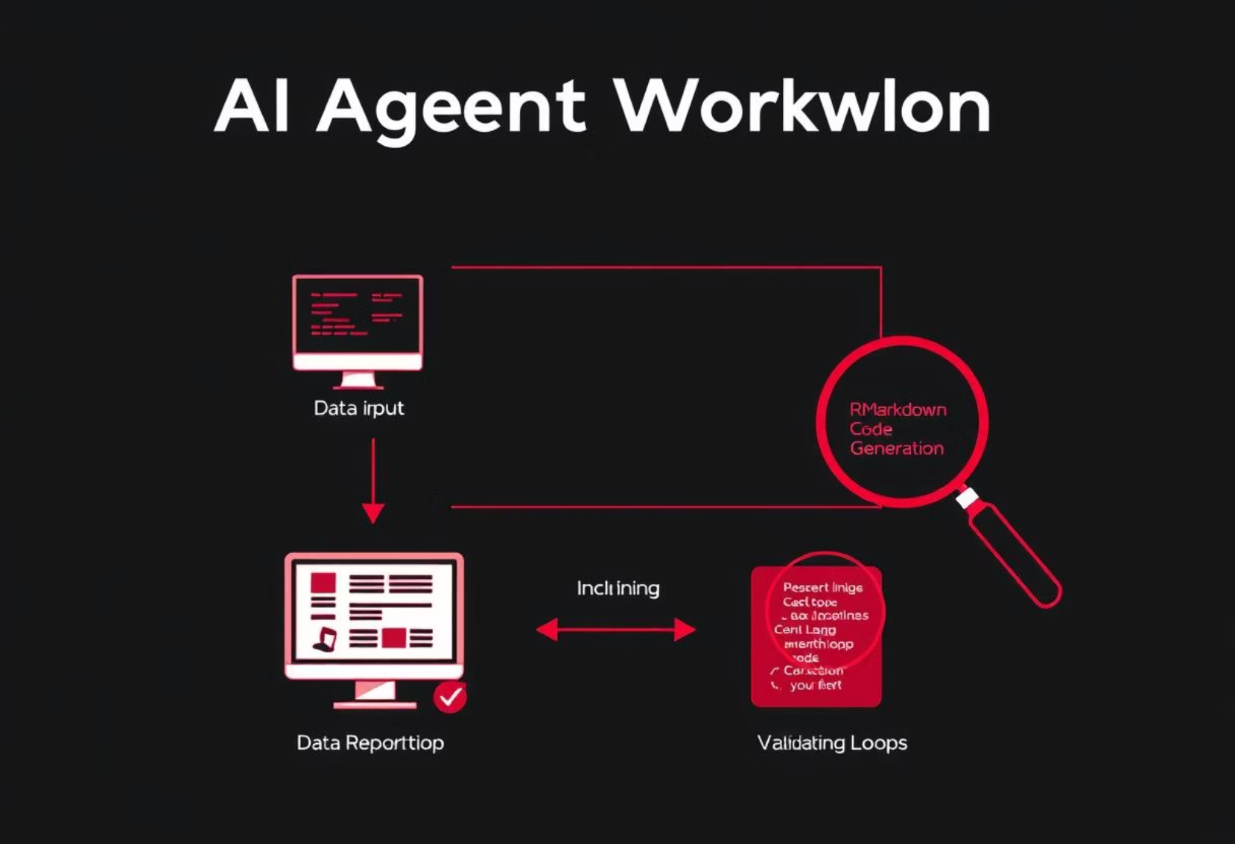
4.0 Case Study: Adolescent Reproductive Health Behavior
To generate the HTML report, a specific workflow was implemented leveraging AI assistance within Cursor:
AI Model Selection: The Claude 3.7 Sonnet model was chosen for its enhanced performance with R language, ensuring robust code generation and analysis.
Initial Agent Prompt: A foundational prompt guided the AI agent's role and operational parameters.
Prompt: "You are an AI agent that creates data reports. You create reports by writing code to an Rmarkdown file (with github_document output), knitting that file, then reading the output md file to validate your work. You repeat this edit, knit, review loop until the reporting task is achieved. Use plots, tables, and inline R code where appropriate. Code should be hidden from the output."

Slide 7

Specific Task Prompting
Following the initial agent setup, a detailed task prompt was provided to direct the AI in generating specific visualizations and interpretations for the Uganda DHS dataset:
Task Prompt: "Now create a data report in my Rmd file using the dataset I've provided. The report should: 1. Load the data in my folder. 2. Create a bar graph of marital status by residence. 3. Create a bar graph of marital status by education. 4. Create a bar graph of marital status by wealth. 5. Provide a brief interpretation of the relationship shown in the bar graph."

Slide 8

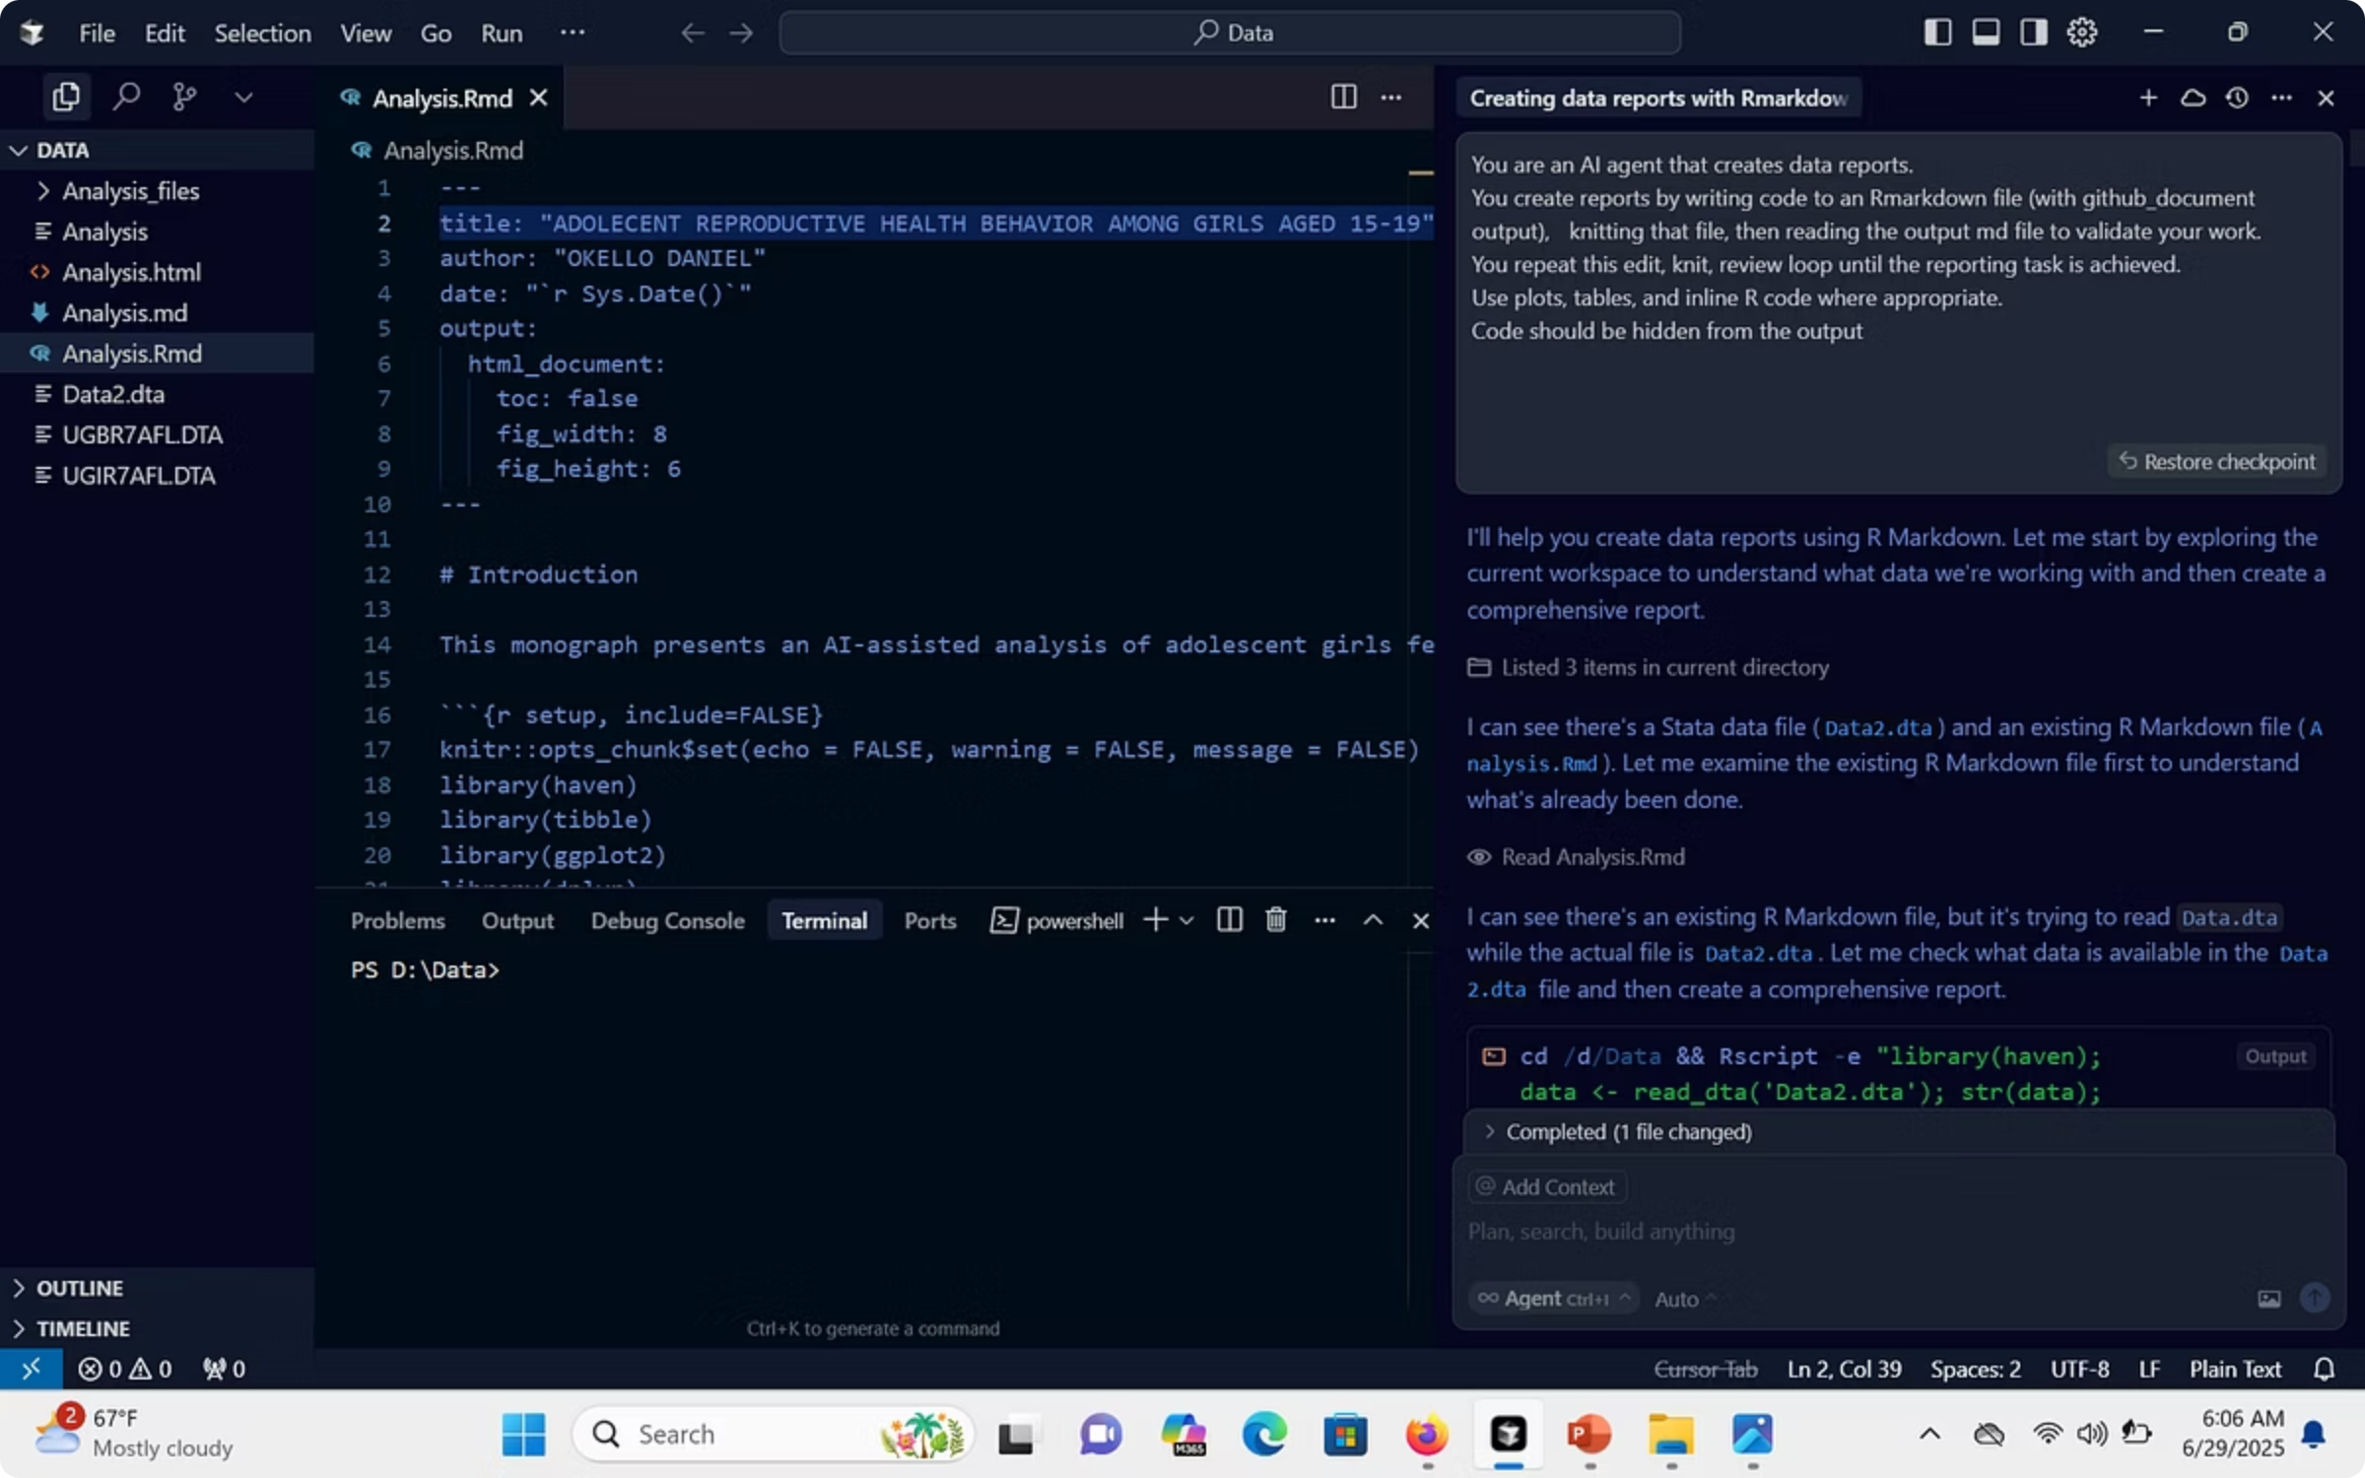

4.2 Cursor Interface: Code Generation
This screenshot illustrates Cursor's integrated environment where the AI generates R code based on the given prompts. Notice the intuitive layout that combines code editor with AI chat for seamless interaction, facilitating efficient data analysis and report generation. The AI-generated code is clearly visible, ready for execution and validation.

Slide 9

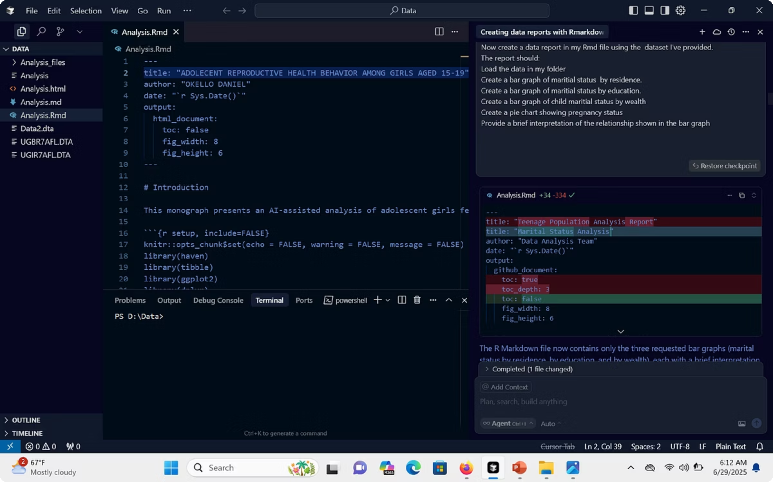

Cursor Interface: Specific Task Prompting
This screenshot illustrates specific task prompts put in Cursor's integrated environment.

Slide 10

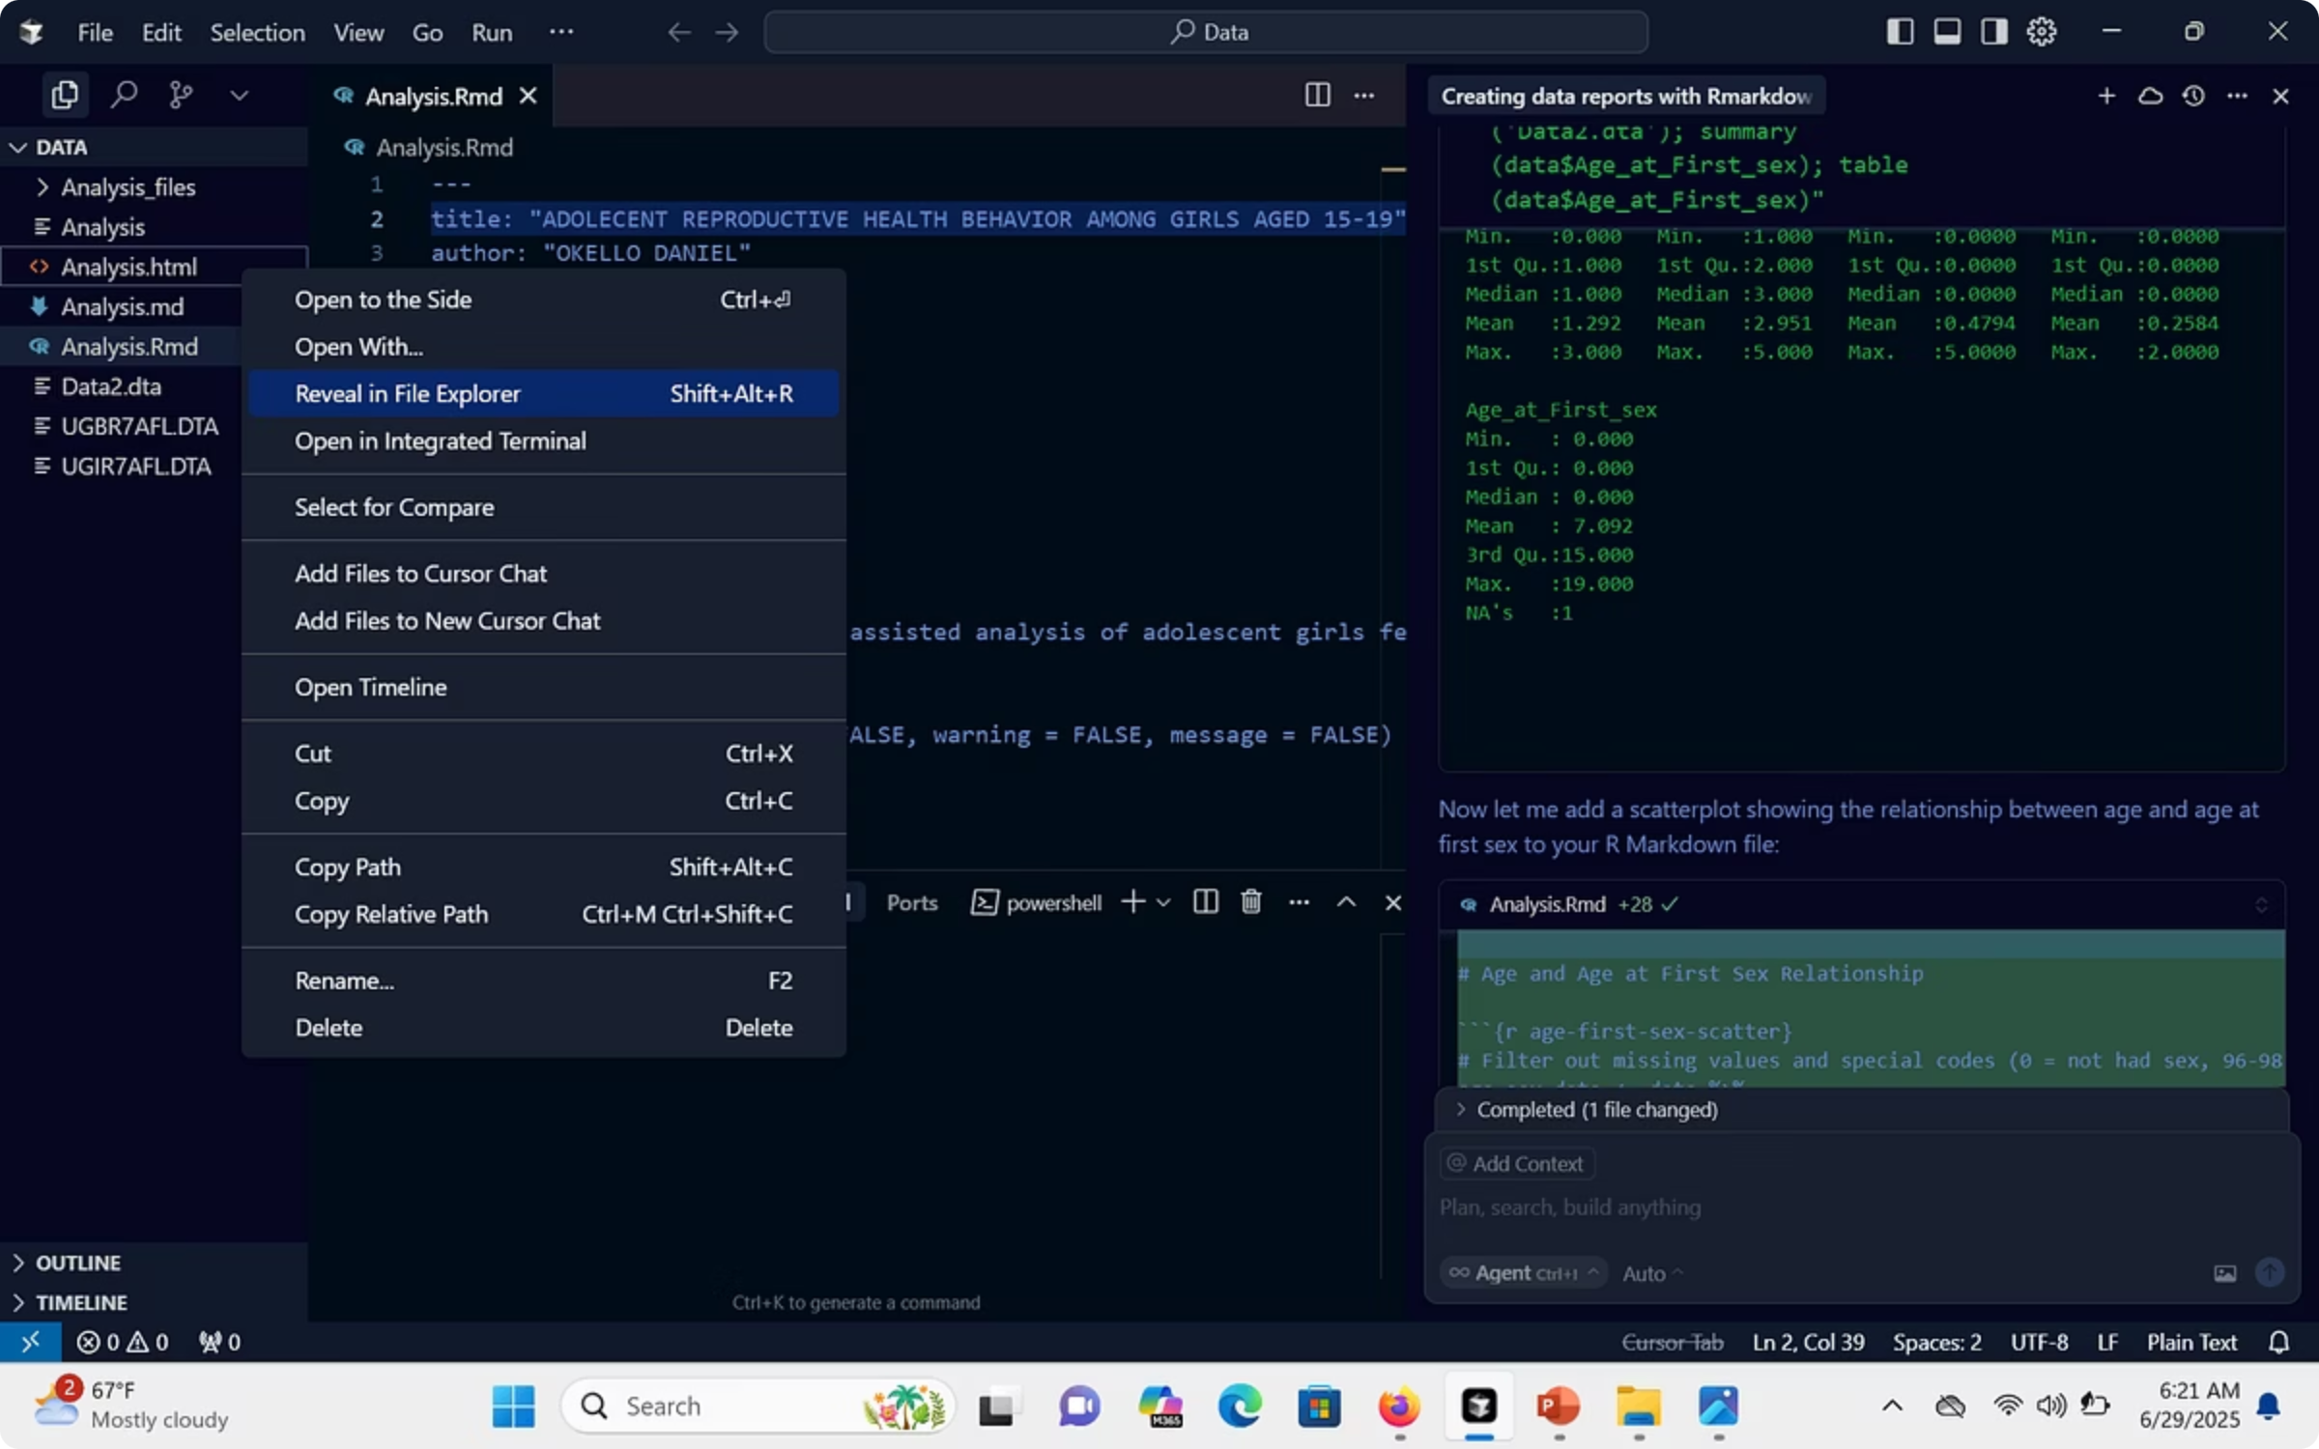

Generated Report Snippet
This screenshot displays a portion of the automatically generated HTML report file in the Data. To open the file right click and click on option Reveal in file explorer to view the file

Slide 11
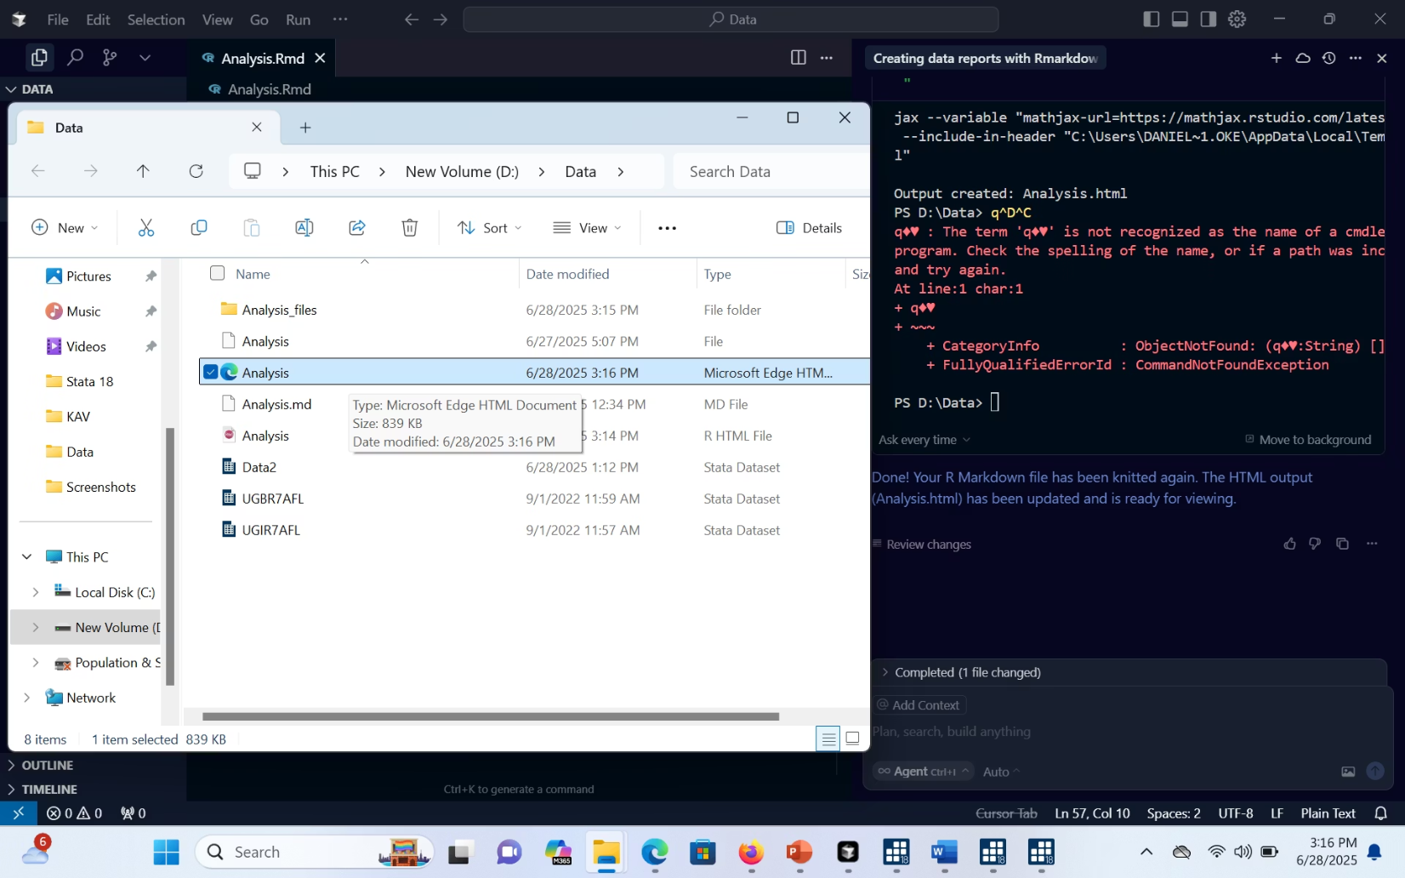

Final report file (HTML or PDF)
This shows the final report file, available in HTML or PDF format.

Slide 12


Final report file (HTML or PDF)
Copy the link and paste on your URL to open the published report in GitHub
https://christianwalk.github.io/Final_project/index.html.

Slide 13
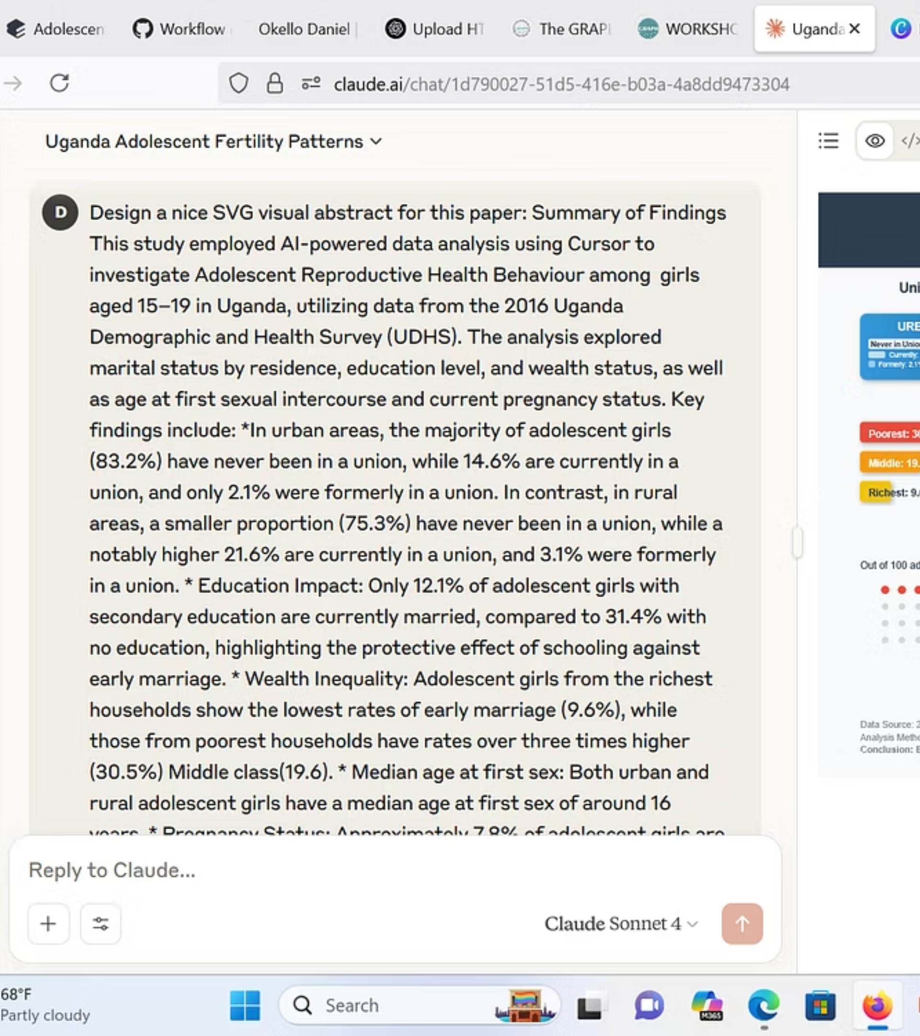
Instructions prompt
SVG Visual Abstract
SVG stands for Scalable Vector Graphics. It is an XML-based image format used to describe two-dimensional graphics. When visualizing your abstract—especially in research or data summaries.
This can be done in Claude A.I or Chat gbt.
Output

Slide 14
Adolescent Reproductive Health Behaviour in Uganda
Girls aged 15-19 | 2016 Uganda Demographic and Health Survey
AI-powered analysis using Cursor
Marital Status by Residence
Girls Married by Education Status
SVG downloaded file from Claude A.I
URBAN
RURAL
No Education: 31.4%
Never in Union: 83.2%
Never in Union: 75.3%
Secondary Education: 12.1%
61% Reduction
Currently: 14.6%
Currently: 21.6%
Formerly: 2.1%
Formerly: 3.1%
Girls married by Wealth Status
Median Age at First Sex
Poorest: 30.5%
16
Both Urban
Middle: 19.6%
3.2x
and Rural
Higher Risk
years
Areas
Richest: 9.6%
for Poorest
Current Pregnancy Status
Key Policy Implications
Out of 100 adolescent girls:
• Rural girls face 48% higher risk of early union (21.6% vs 14.6%)
7.8%
• Education reduces marriage risk by 61% (31.4% → 12.1%)
• Wealth disparity creates 3.2x risk difference across economic levels
• Sexual debut occurs at median age 16 regardless of residence
Currently
• Nearly 8% current pregnancy rate requires immediate intervention
Pregnant
Priority: Education access + wealth inequality reduction + rural outreach
Urgent Need for
Reproductive Health
Interventions
Data Source: 2016 Uganda Demographic and Health Survey (UDHS)
Analysis Method: AI-powered data analysis using Cursor | Study Population: Girls aged 15-19
Conclusion: Education and wealth serve as protective factors against early reproductive health risks

Slide 15

Any questions?
Thank you for your time. Iam here to answer any questions you may have.

